Slide 1

Netflix Data Analysis
K Ranga Nitheesh Kumar Reddy
APPLY_175569249068a5bdca6dbf5

Slide 2

PROBLEM STATEMENT
Netflix is one of the world’s leading streaming platforms, offering a vast collection of movies and TV shows that continues to grow through original productions and licensed content.
However, with increasing competition from platforms such as Amazon Prime Video, Disney+, and various regional OTT providers, Netflix needs to strategically analyze its content catalog to identify strengths, gaps, and opportunities.
This project focuses on “Content Trends Analysis for Strategic Recommendations.” The goal is to explore how Netflix’s content distribution — in terms of Movies vs. TV Shows, Genres, and Country-wise contributions — has evolved over time.
Through this analysis, we aim to uncover key trends, audience preferences, and insights that can guide data-driven decisions for Netflix’s future content strategy and global market expansion.

Slide 3
Project Description
Analyze the distribution and growth of Movies and TV Shows on Netflix over the years.
Identify the most frequent genres and track changes in their popularity.
Compare country-wise contributions to assess Netflix’s global content diversity.
Provide strategic recommendations for future content acquisition and production.
Significance of the Study
Understand Netflix’s content evolution and audience engagement patterns.
Identify popular genres and underrepresented regions to guide decisions.
Support data-driven strategies for:
- Balancing global vs. local productions
- Recognizing market trends and regional preferences
- Investing in specific content types and countries

Slide 4

WHO ARE THE END USERS?
Netflix Management & Strategy Team – for strategic content planning and decision-making
Netflix Content & Production Teams – to guide content creation and acquisitions
Netflix Data Analytics & Insights Department – for actionable analytics on content trends
Data Analysts & Data Scientists – in the OTT/media industry, to benchmark or analyze patterns
Academic Researchers & Students – studying data analytics, media trends, or streaming platforms
Business Analysts & Market Researchers – for market intelligence and competitive insights

Slide 5

Technology Used
Python – for data analysis and processing
Jupyter Notebook / Google Colab – for coding, visualization, and collaborative work
NumPy – for numerical computations and data manipulation
Matplotlib – for data visualization and plotting

Slide 6
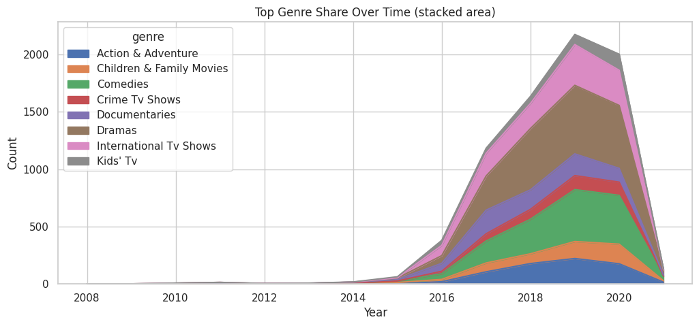
RESULTS1

Slide 7
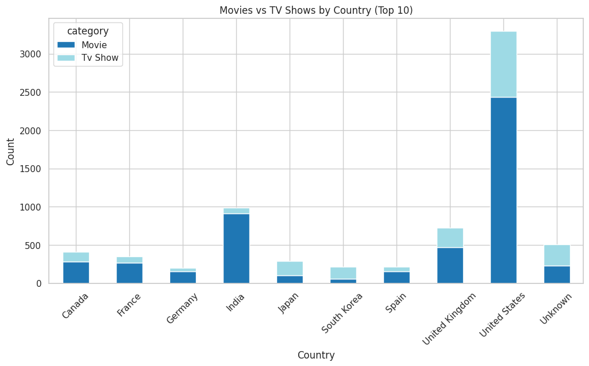
RESULTS2

Slide 8
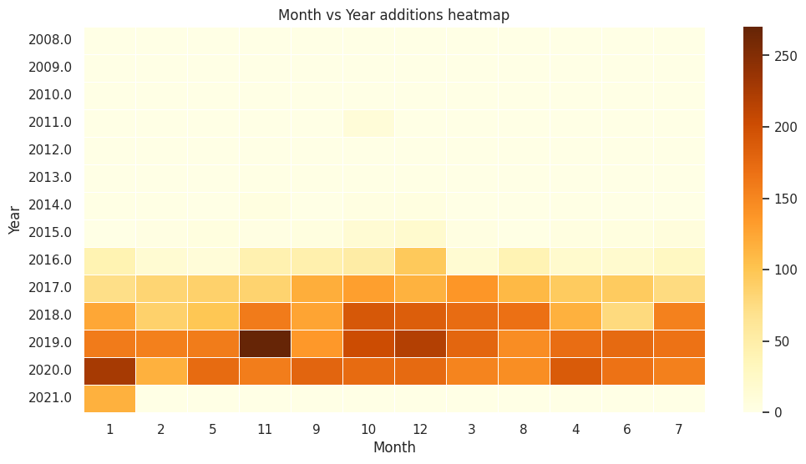
RESULTS3

Slide 9
GitHub repository
https://github.com/Krnkreddy/VOIS_AICTE_Oct2025_MajorProject_KRangaNitheeshKumarReddy.git

Slide 10
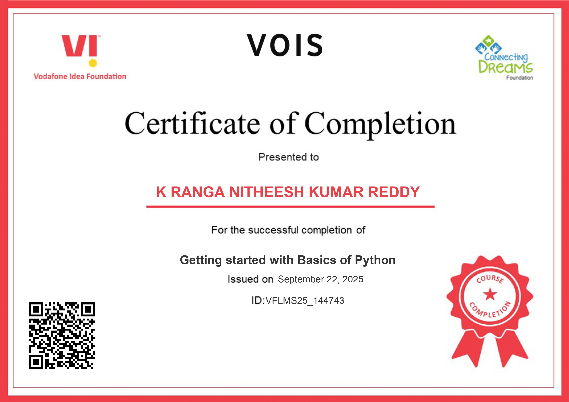
Getting started with Basics of Python Certificate

Slide 11

Data Visualization Certificate

Slide 12
Thank you
.
.

